Slide 1

Parks and Recreation Community Facilities Operations Plan
Findings Presentation
Presented to:
August 2013

Slide 2
Agenda
Project Planning Process
Community Input
Demographics
Program & Facility Analysis
Individual Community Center Market Analysis for the Center Region
Operation & Governance Assessment
Employee Assessment
Operational & Business Analysis
Recommendations

Slide 3
Project Planning Process

Slide 4
Project Planning Process
Vision and Mission
Demographic, Trends & Market Analysis
Community Center Assessment
Public Input
Organizational Analysis & Service Classification
Operational & Business Analysis
Financial & Operations Strategy
Assessment and Operating Plan

Slide 5
Community Input
PROS Consulting conducted twenty-seven (27) focus groups along with nine (9) public forums at eight of the nine community centers (Southeast and Marlborough held together)

Slide 6
Consultants Observations from Community Input
The Department is more of a recreation facility provider than a direct program and facility provider
Parks are more recognized and appreciated than recreation services by the community
The road signage to get to parks and recreation facilities is minimal which doesn’t help the community to understand the location and opportunities that exists for recreation services
Many of the community centers have excess capacity of program spaces that could be used in a more efficient and productive manner
It appears that the majority of the community centers do relatively the same types of programs

Slide 7
Consultants Observations from Community Input
Program standards are not consistently applied across the system
The organizational structure of the Recreation Division is center based versus system based
The cost recovery rates desired for facilities and programs are not well defined
Many of the fitness rooms in recreation centers are too small to garner the level of users to achieve a high level of success and use
More open multipurpose space needs to be considered and re-evaluated in the recreation centers

Slide 8
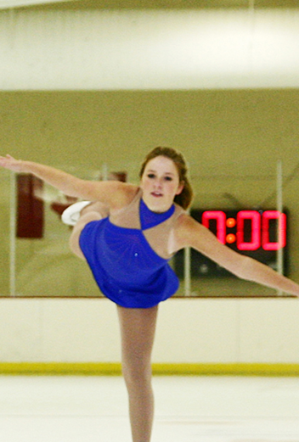
Consultants Observations from Community Input
Most of the gym floors are in need of refurbishing
Customer service standards are inconsistently applied across the system
True cost of services is not being tracked by staff for services provided or facilities provided to determine unit costs to provide the services
Outdoor pools are very limited in size to support a variety of aquatic experiences

Slide 9
Consultants Observations from Community Input
Classification of programs as core essential, important and value added needs to be addressed
Performance measure tracking is missing at most of the community centers to demonstrate outcomes desired
Youth use of fitness equipment is not allowed and the Department should consider the YMCA model for access with set times of the day with adult supervision present in the room
Staff in the field and the community desire to see key recreation administrators more in the field to share their issues with them to help improve their programs and services

Slide 10
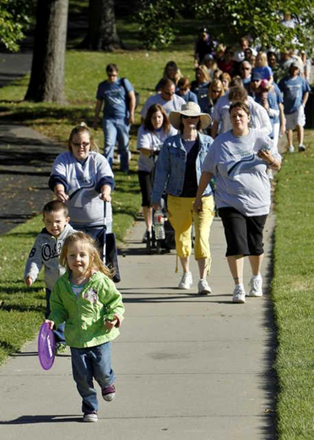
Consultants Observations from Community Input
Concession services and vending is limited in most centers
Stepped up marketing of services is desired from the community throughout the city
Hours of operation are a concern of many people and they would like to see hours adjusted where possible to meet their needs
Many of the Community Centers serve a specific population and could be more multi-generational

Slide 11
Demographics

Slide 12
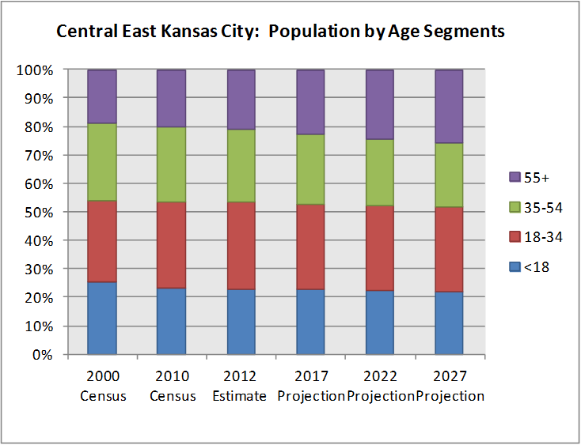
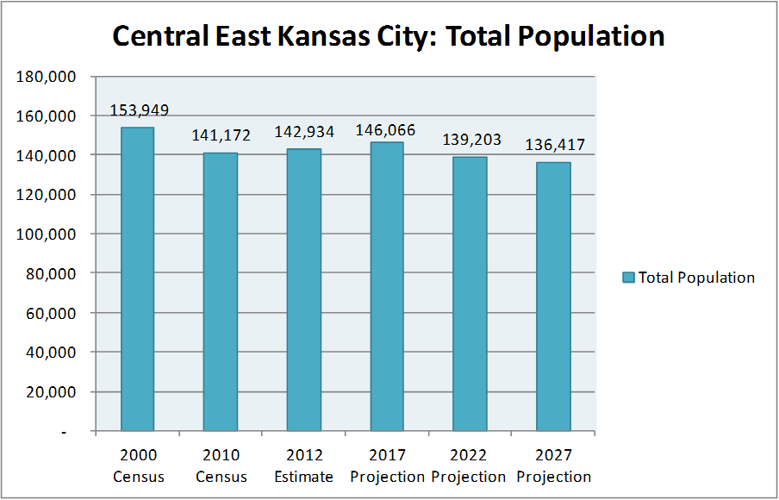
Central East Kansas City
Decreasing Population
Fairly balanced age segment

Slide 13
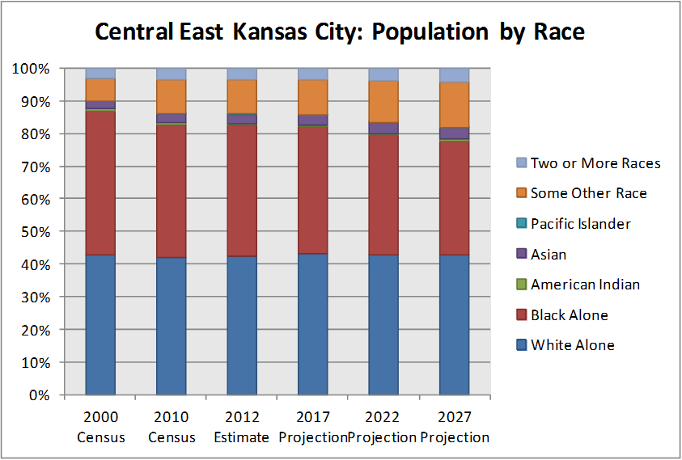
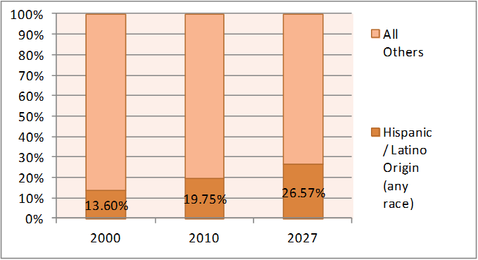
Central East Kansas City
Very diverse
Growing Hispanic/Latino population

Slide 14
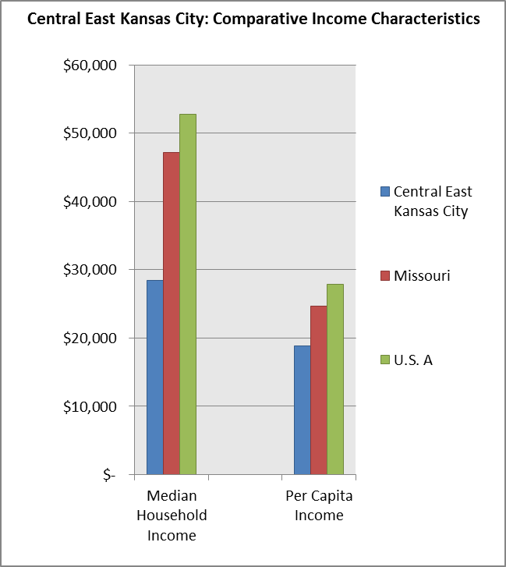
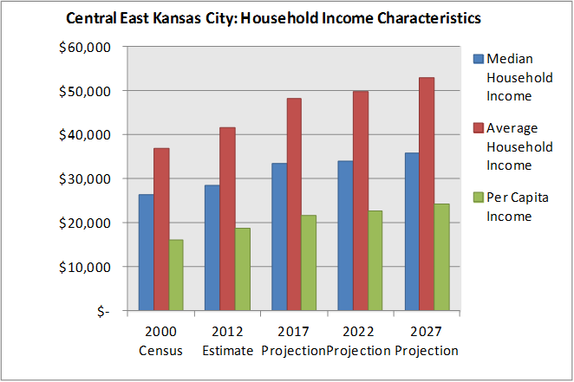
Central East Kansas City
Gradual income growth
Significantly lower than State and National averages

Slide 15
Program and Facility Analysis

Slide 16
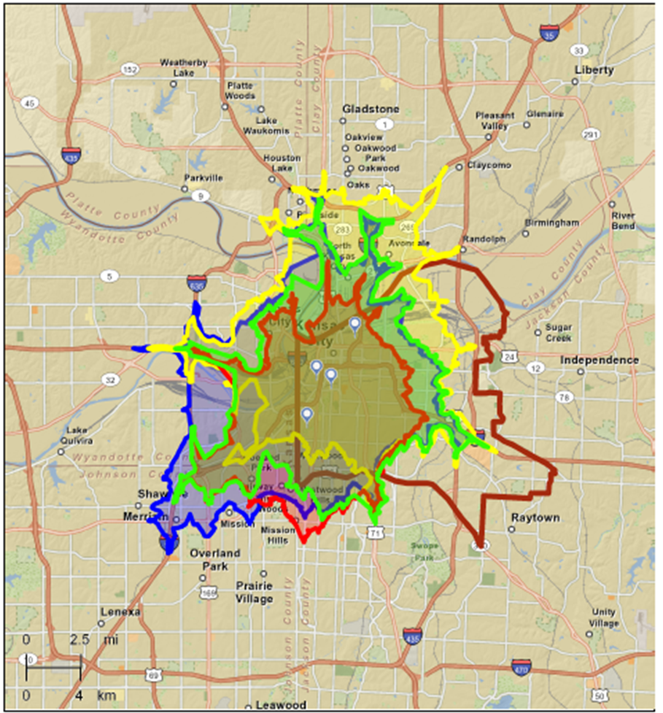
Central East 10 Minute Drive Time Map
The centers in the Central East region are closely clustered and cover a small and virtually identical target audience
Each center is within a 10 minute driving distance of the other and this translates into a high level of service duplication as well as low cost recovery in the area

Slide 17
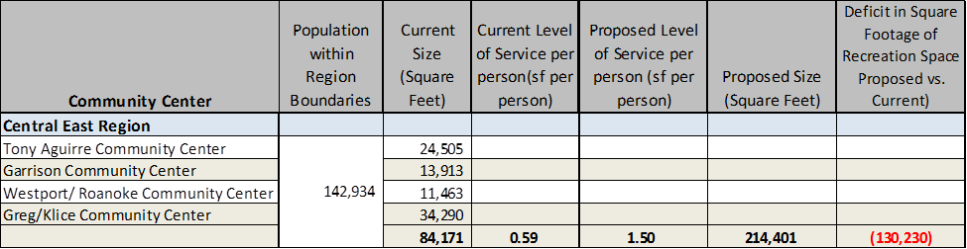
Central East Level of Service
The Central East Region has a population of 142,934 which is being served by approximately 84,171 square feet i.e. 0.59 s.f. /person. This translates to a less than recommended level of service and expansion of existing recreation centers along with new recreation centers would be required to address the shortfall.

Slide 18
Individual Community Center Market Analysis for the Central Region

Slide 19
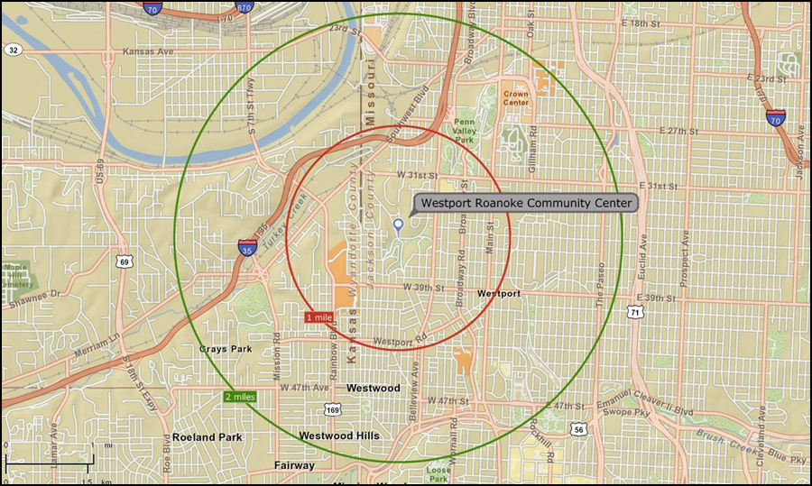
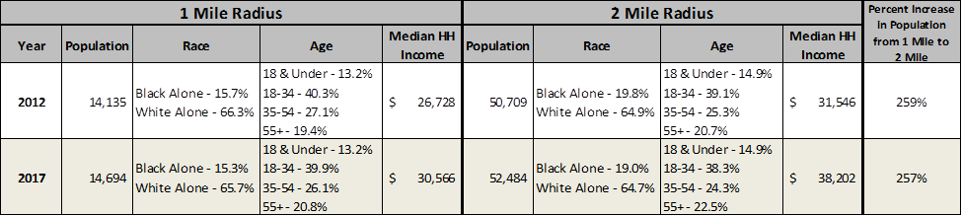
Westport Roanoke Community Center
Extremely high young adult/ family (18-34) age segment
Population is skewed towards White Alone, with over 60% of the population

Slide 20
Westport Roanoke Community Center
ACTION PLAN
  With 40% of the age segment being 18-34, it would benefit the center to offer continued education programs and affordable child care to accommodate young working parents
  Offering additional programming for young children that are in pre-school and elementary school should be considered
  With many of the household being start-up households, it would be good to offer low cost / affordable programming

Slide 21
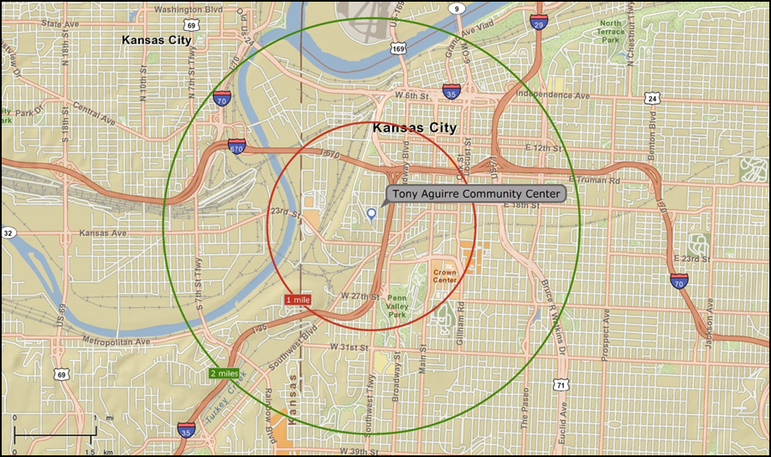
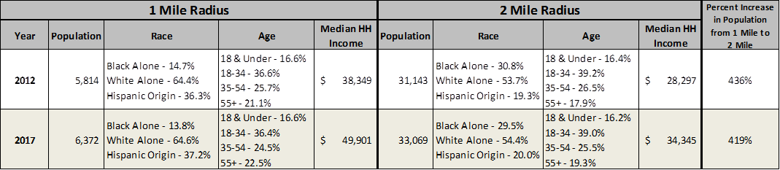
Tony Aguirre Community Center
A high Hispanic origin located in the 1 mile radius (36%) but drops to 19% in the 2 mile radius
The population is skewed towards the 18-34 age segment in both radii

Slide 22
Tony Aguirre Community Center
ACTION PLAN
  Offer programming that cater to the high ethnic diversity found in the community
  Based on tapestry information, it would benefit the center to create more special events that bring the community together
  Offer low cost childcare and programming for youth children in preschool and elementary school

Slide 23
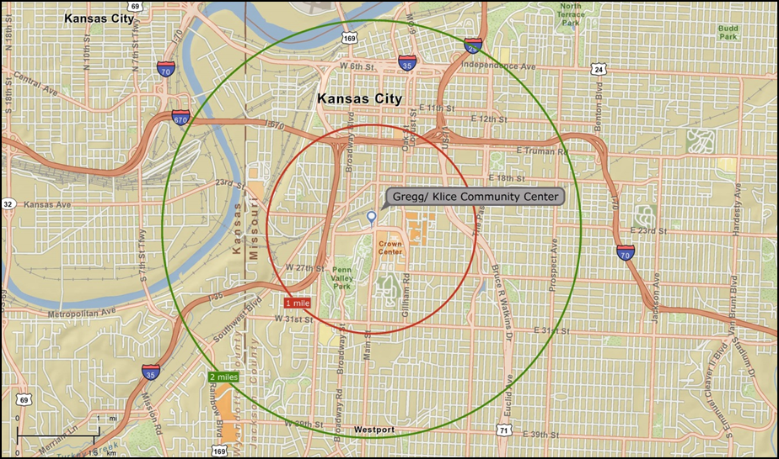
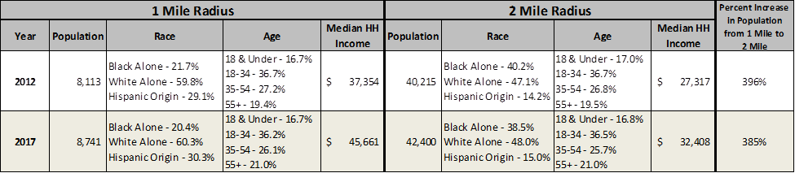
Gregg Klice Community Center
Gregg Klice echoes Tony Aguirre with a high Hispanic origin and a skewed age segment (18-34) in both radii
Median household income is higher in the 1 mile radius ($37,354) compared to the 2 mile radius ($27,317)

Slide 24
Gregg Klice Community Center
ACTION PLAN
  Offer programming that cater to the high ethnic diversity found in the community
  Based on tapestry information, it would benefit the center to offer trips, social events, and trendy exercise classes for young adults
  Offer low cost childcare and programming for youth children in preschool and elementary school

Slide 25
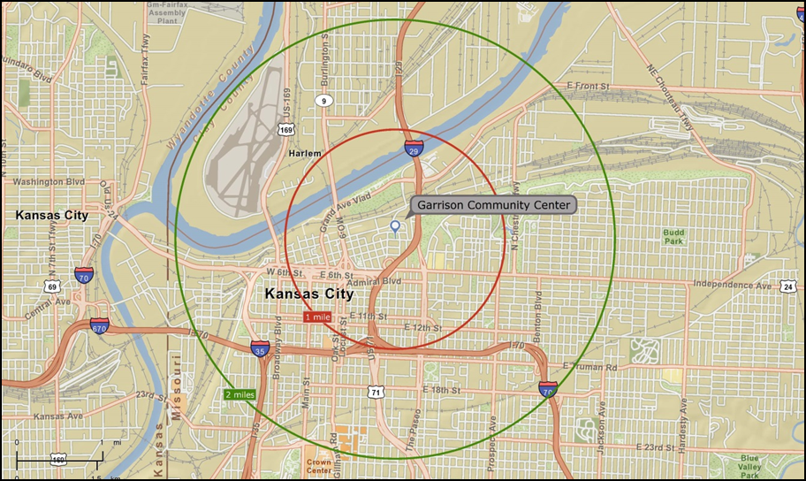
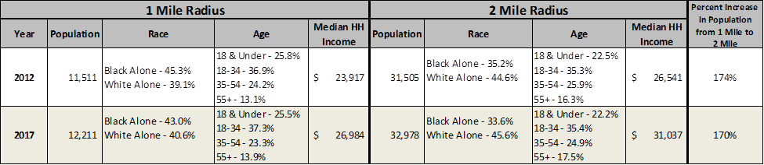
Garrison Community Center
Age segment is skewed towards the 18-34 age segment (about 35%) with a small senior population around 15%.
White and Black Alone each make up about 40% of the population

Slide 26
Garrison Community Center
ACTION PLAN
  Offer programming that cater to the high ethnic diversity found in the community
  Offer programming for family’s to enjoy together such as trips to the zoo and theme parks
  Offer low cost childcare and programming for youth children in preschool and elementary school

Slide 27
Operation and Governance Assessment

Slide 28
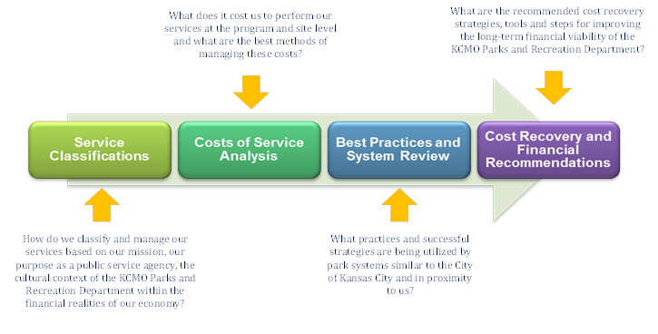
Governance Analysis & Classification of Services

Slide 29
Service Classification Descriptions
CRITERIA TO CONSIDER | CORE ESSENTIAL PUBLIC SERVICES |  | IMPORTANT PUBLIC SERVICES | VALUE ADDED SERVICES
Public interest or developmental importance as well as mandated by law and is mission aligned | High Public Expectation |  | High Public Expectation | High Individual and Interest Group Expectation
Financial sustainability | Free, Nominal or Fee Tailored to Public Needs __ Requires Public Funding |  | Fees Cover Some Direct Costs __ Requires a Balance of Public Funding and a Cost Recovery Target | Fees Cover Most Direct and Indirect Costs __ Some Public Funding as Appropriate
Benefits – i.e. health, safety, and protection of a valuable asset. | Substantial Public Benefit (negative consequence if not provided) | Public and Individual Benefit |  | Primarily Individual Benefit
Competition in the market | Limited or No Alternative Providers |  | Alternative Providers Unable to Meet Demand or Need | Alternative Providers Readily Available
Access | Open Access by All |  | Open Access / Limited Access to Specific Users | Limited Access to Specific Users

Slide 30
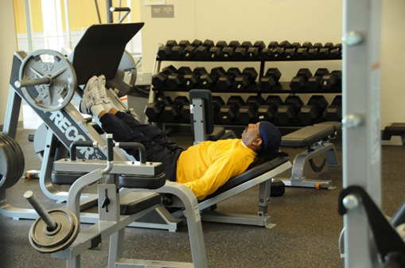
KCMO PARKS AND RECREATION DEPARTMENT CLASSIFICATIONS
Typical Core Essential Programs recover 0-20% of the operational costs:
  Open swim
  Teen swim
  Community festivals
  Fitness center drop-in
  Outdoor adventure programs
  First Friday programs
  Senior classes
  Therapeutic programs
  Family programs
  Drop in basketball for exercise

Slide 31
KCMO PARKS AND RECREATION DEPARTMENT CLASSIFICATIONS
Important Services Programs recover 20-80% of the operational costs:
  Preschool swim lessons
  Children swim lessons
  Senior aquatic programs
  Life skill classes
  Preschool classes
  Parent and child classes
  Summer day camps
  T-ball program
  Youth team basketball
  Youth team basketball
  Youth boxing
  Silver sneakers for seniors
  Biddy basketball
  Soccer leagues
  Sports Clinics for kids
  Youth tennis lessons
  Arts programs
  Performing arts programs
  Youth hockey programs

Slide 32
KCMO PARKS AND RECREATION DEPARTMENT CLASSIFICATIONS
Valued Added Services recovery 80-100% of their operational costs:
  Aqua aerobics
  Aqua fitness classes
  WSI instruction
  Lap swim
  Specialty classes
  Private swim lessons
  Martial arts
  Archery
  Personal training
  Dog obedience classes
  Yoga
  Zumba
  Computer Classes
  Aerobics
  Volleyball leagues
  Basketball leagues for adults
  Pickle Ball Leagues
  Private rentals of community space
  Dodge ball
  Piano Lessons
  Tennis lessons
  Senior trips
  Hockey tournaments

Slide 33
Employee Assessment
Over 30 Center Directors and Assistant Center Directors participated in this survey which serves as a good yardstick to assess current employee sentiment at a point in time. These surveys were conducted in April-May 2013.
Malcom Baldridge Model used

Slide 34
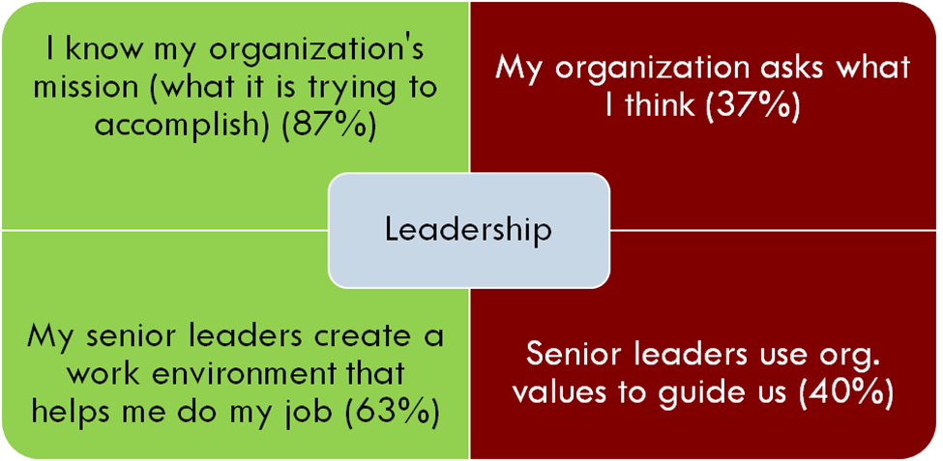
Leadership

Slide 35
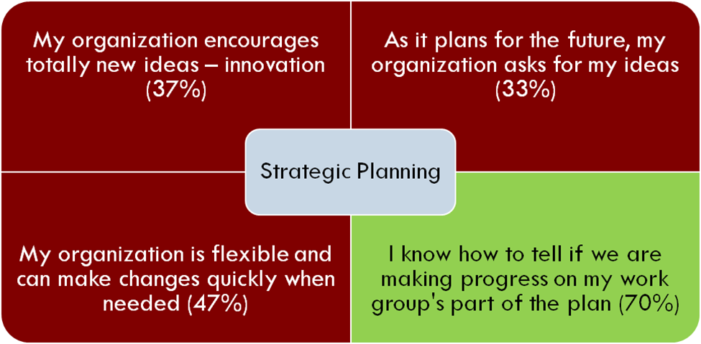
Strategic Planning

Slide 36
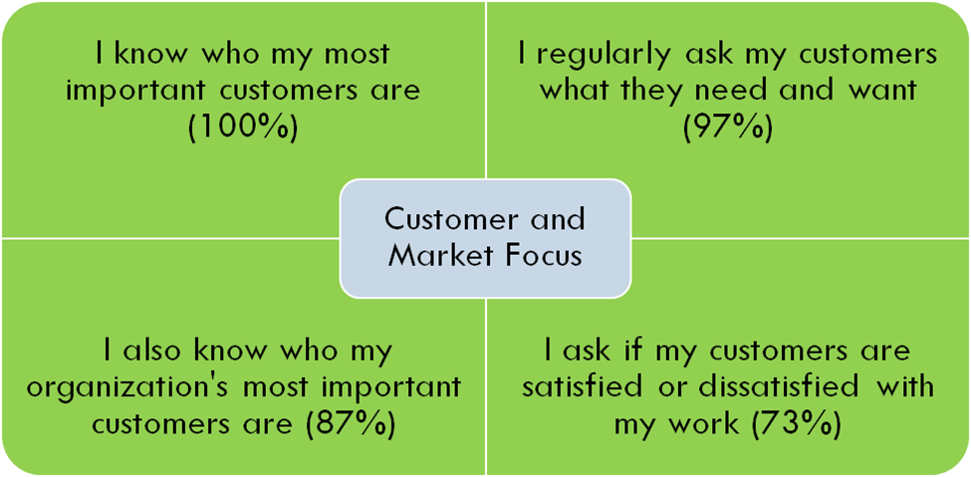
Customer and Market Focus

Slide 37
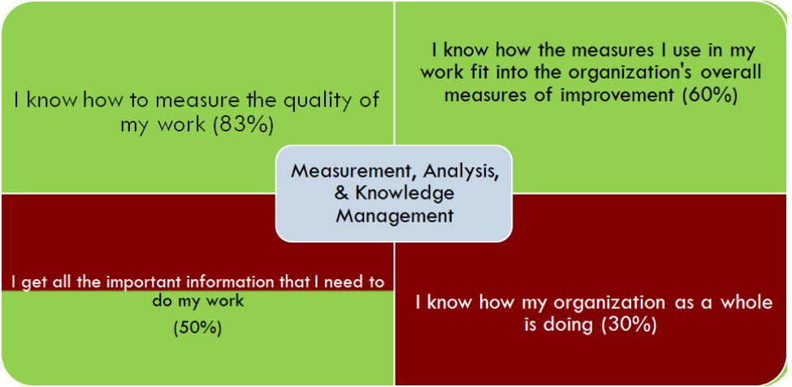
Measurement, Analysis, & Knowledge Management

Slide 38
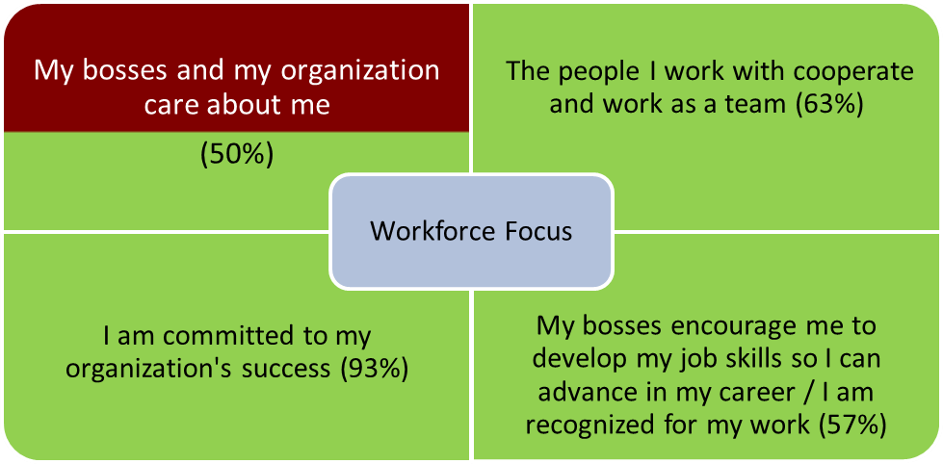
Workforce Focus

Slide 39
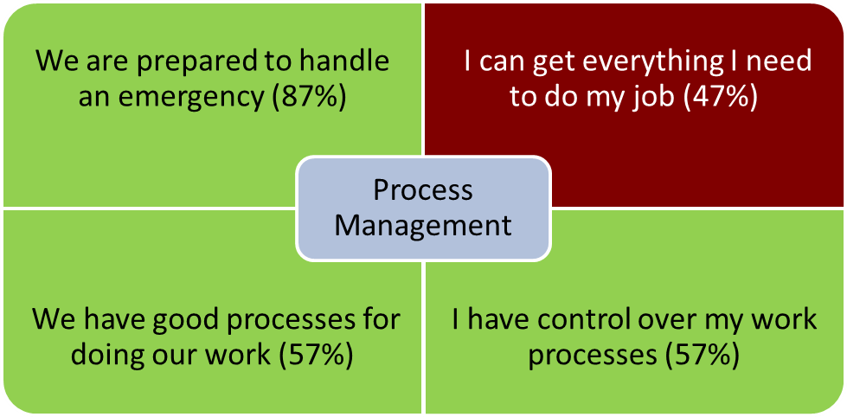
Process Management

Slide 40
Operational and Business Analysis

Slide 41
Operational and Business Analysis Recommendations
HOW ARE THE OPERATIONAL AREAS STRUCTURED?
  Recommendation – Recreation Services should be divided into three districts with a manager over each District with city wide services
DOES THE CURRENT ORGANIZATIONAL STRUCTURE LEND ITSELF TO MAXIMIZING REVENUES AND CONTROLLING EXPENDITURES?
  Recommendation - Redesign the recreation division into regional districts and city-wide services to maximize the functionality and revenue capability of the division

Slide 42
Operational and Business Analysis Recommendations
DETERMINE THE RELIABILITY AND INTEGRITY OF FINANCIAL AND OPERATIONAL INFORMATION
  Recommendation - Acquire the modules needed for tracking cost of service from RecTrac
DETERMINE THE EFFECTIVENESS, EFFICIENCY AND ECONOMY OF THE OPERATIONS
  Recommendation - Develop business plans for each recreation center and or attraction

Slide 43
Operational and Business Analysis Recommendations
DETERMINE if OPERATIONS ARE SUSTAINABLE
  Recommendation - Establish an updated pricing policy and cost recovery goal for the recreation division as a whole and for each recreation site and core program area
DETERMINE IF ASSETS ARE SAFEGUARDED
  Recommendation - Develop a cost benefit assessment for each improvement planned. Prioritize these improvements to achieve the financial goals desired for the Department and the Division.

Slide 44
Operational and Business Analysis Recommendations
DETERMINE IF SAFETY AND RISK MANAGEMENT GOALS ARE IN PLACE
  Recommendation - Develop a customer and staff safety plan for each site and implement changes required
DETERMINE THAT THE OPERATIONS ARE IN COMPLIANCE WITH APPROPRIATE LAWS, REGULATIONS AND CONTRACTS
  Develop a review schedule for each contract and agreement in the system and update accordingly

Slide 45
Key Recommendations

Slide 46
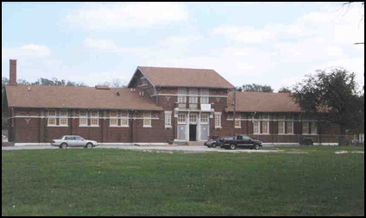
Key Preliminary Recommended Actions
Reorganize the Recreation Division into three functional Districts that will be responsible for three or four community centers
  Program by regional district versus focusing on each community center as its own stand-alone center
Add additional space to smaller community centers to create more program space and increase the operating revenues from the site
Reopen the pool at Line Creek

Slide 47
Key Preliminary Recommended Actions
Eliminate duplication of programs in each District unless the program demand requires it and develop specific themes for each community center
  Active Seniors and Family Programing (senior programs, senior wellness, family activities)
  Fine Arts and Performing Arts (fine arts, performing arts, music, dance)
  Sports, Fitness and Wellness (sports leagues, fitness and wellness programs, clinics and workshops)
  Aquatics and Fitness (aquatic programs, aquatic fitness, swim teams, fitness and wellness classes)
  Life Skill Center (computer skills, cooking, gardening, healthy eating, reading, English classes, neighborhood focus)
  Ice Center (ice hockey, figure skating, clinics, tournaments)

Slide 48
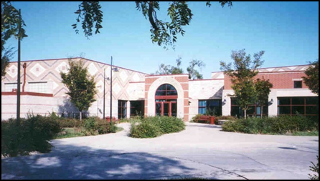
Key Preliminary Recommended Actions
Add additional core programs to broaden the program offerings and user base to include:
  Before school and after school programs
  Family programs
  Senior programs
  Wellness classes
  Arts programs
  Aquatics programs
  Adult sports
  Outdoor recreation

Slide 49
Key Preliminary Recommended Actions
Develop an updated pricing policy and philosophy based on core essential, important and value added programs and create specific cost recovery goals for each community center and core program area.
Develop earned income programs for each community center to increase revenues for each site.
Develop a business development office for the Recreation Division to generate more revenue and support a stronger marketing effort
Develop performance measures that focus on accountability, efficiency and revenue production

Slide 50
Key Preliminary Recommended Actions
Develop a program plan for aquatics to strengthen the programs offered.
Develop a stronger volunteer program to help staff
Redevelop city-wide programs in adult sports, some youth sports, Teen services (ages 12-17), aquatics, fitness, preschool programs (3-6 with parents), senior services, arts and dance, outdoor recreation, after school programs, and ice related programs.
Develop more contractor related classes with a 60/40 split in revenue back to the Department.

Slide 51
Key Preliminary Recommended Actions
Develop consistency in how program standards are delivered for youth and adults.
Develop consistency in community center cleanliness standards.
Develop consistency in how community centers are staffed based on prime time and non-prime times.
Develop consistency in recreation staff training and development as it applies to programming, pricing, marketing, communication, customer service, RecTrac management and performance tracking.
  Develop employee work plans and employee work teams to implement the goals and objectives listed in the Recreation Plan.

Slide 52
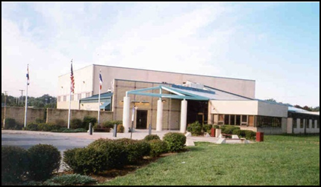
Key Preliminary Recommended Actions
Design recreation facilities to produce revenue and create larger spaces for fitness, aquatics, gyms, walking tracks and wellness related rooms.
Increase partnerships with local schools, not-for-profits, health care providers, and private businesses in delivery of programs to the community.
Develop more teen programs offering an array of programs that might include social recreation, music, tutoring, mentoring and non-sports activities for both girls and boys.

Slide 53
Key Preliminary Recommended Actions
Develop adventure programs for youth and adults in kayaking, mountain biking, rock climbing, scuba diving, skateboarding, and paddle boarding.
Increase the program development for youth and adults in swimming instruction and recreational swimming for youth.
Develop a second sheet of ice at the Line Creek Community Center to increase leagues and tournaments to help support the facility to become more self-supporting.

Slide 54
Key Preliminary Recommended Actions
Complete a comprehensive marketing plan and program business plan that gives consideration and identifies potential promotional strategies for each of the following:
  Networking-go where the market is;
  Direct marketing-brochures and flyers;
  Advertising-print media, directories;
  Training programs-to increase awareness;
  Write articles-give advice, become known as the expert;
  Direct/Personal selling;
  Publicity/press releases;
  Step up social media;

Slide 55
Questions?
Parks and Recreation Community Facilities Operations Plan
Findings Presentation

