Slide 1
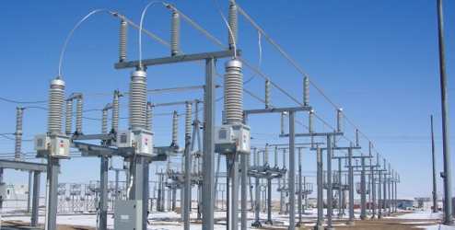
The Westside Says “NO” To KCP&L’s
2nd Electrical Substation
Kansas City Power &Light (KCP&L) wants to erect a 2nd electrical substation in the Westside on property owned by DST. It will be situated just north of the two- story Porters’ Dormitory building, (2530 Southwest Blvd.,) directly across the street from the Boulevard Brewing Company .
The transmission poles will rise 125 to 140 feet from the structure which could make them 200 feet above the sidewalk /street level.
KCP&L hosted two informational meetings at Guadalupe Center Inc. in the Fall of 2008. Spokespersons said it was decided to put the substation here because it was cheap and easy. KCP&L has been planning this substation since 2001.
We say “NO Substation.” We say “NO More Environmental Hazards” in the Westside.

Slide 2

.
What is an electrical substation and what does it do? An electrical substation houses equipment (“transformers”) that “step down” electricity from the high voltages needed for efficient long-distance transmission to the lower voltages appropriate for shorter-distance transmission and for distribution to residential and commercial end users. The other key component of a substation is “switchgear” (sophisticated circuit breakers and switches) to cut power when necessary. These features are supplemented by relays, capacitor banks, and battery backup arrays. There can be several levels of substations stepping down electricity on its trip from generation station to a home or business (Ordinary operation of a substation does not require personnel to be on site. Staff manage the equipment in real time from other locations, as substations feature automated systems for fault detection, fire suppression, and remote monitoring and control.)

Slide 3

Inequitable Distribution of Environmental Burdens
We’ve all heard the expression , “the straw that broke the camel’s back.”
That holds true for the environment as well. Environments and
people can be “broken” or become ill by too many environmental burdens
or stressors.
Water and Soil are polluted or broken by too much garbage, sewage, chemicals,
road salts, fertilizers, human/animal waste or oils.
Air is polluted by too much ozone, tire particles, chemicals and toxins. We in essence “break” it.
In addition to soil, water and air pollution:
Neighborhoods can be broken by too much blight - trash, graffiti, weeds, unkempt property, litter, abandoned buildings, lead, asbestos, noise, light.
People’s health and quality of life can be broken by environmental burdens and stressors. It can be one chemical or all of these different things added up. (Cumulative Environmental Impact)
Some neighborhoods have more burdens or stressors than others. These neighborhoods are often older. In general, these neighborhoods are home to the poor and minorities.

Slide 4

What do we mean by ‘stressors’?
The environment in which we live influences our health and well-being. Environmental Stressor(s) refers to any force or event in the human or natural environment that may cause a person to experience stress. The term also refers to any physical or chemical change in the natural environment that impacts the growth, development, reproduction or physiology of organisms in that environment.
An environmental stressor is any physical, chemical, or biological factor that can cause an adverse effects on ecosystems or human health. New and existing stressors affect all life forms on earth. If a system is unable to effectively adapt, then adverse "health" effects may result.
Some examples of environmental stressors include: noise, light, air pollution, crowding, traffic congestion, fear, terrorism, natural disasters and extremes of temperature.
Studies on the effect of different environmental stressors on people indicate that they can impact people's behavior, mood, cognitive function, physical health and/or psychological well-being.
.

Slide 5
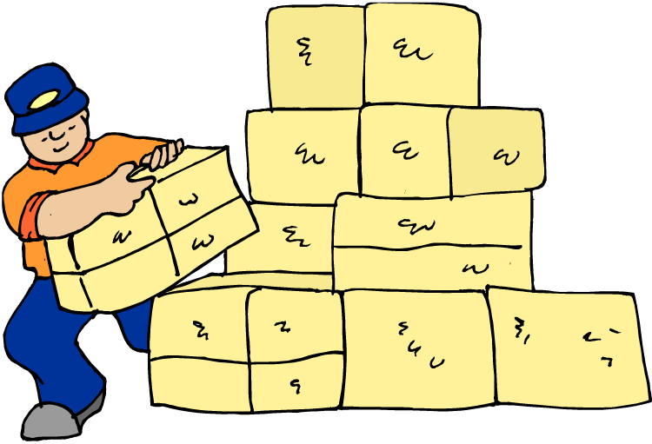
Westside Neighborhood Environmental Issues
Train Cars
KCP&L
Noise –whistles , brakes, clanking
Substation #1
Missouri Gas Energy
Train exhaust
Train cars
Chemicals
Pumping station
Hazardous waste
Gas Stations
Coal
Paints
Turkey Creek
Pumping Station
Lights from store signs, billboards
Neon, blinking, flashing, humming
Solvents
Combustible organics
Street lights, highway lights
Signs & poles
Waste Water
Cars and trucks
Vibrations and noise from
microwaves
Pumping Stations
billboards
Noise -
Air pollution
Cars and trucks
smells

Slide 6
Public Infrastructure:
What Is Essential Public Infrastructure? Public Infrastructure are fundamental facilities and systems serving a country, city, or area, such as transportation and communication systems, power plants, and schools.
The Westside bears a disproportionate (uneven or unfair) share of the burden of essential public infrastructure. Essential public infrastructure on the Westside includes:
Major transportation thoroughfares – I-35, I-670, Southwest Boulevard, Southwest Trafficway, 31st Street, Broadway, Jarboe Street. Summit Street, (approximately 1 million vehicles a week)
Railroad lines and yards (Kansas City Terminal Railroad, Union Pacific, BNSF et al)
Turkey Creek Water pumping station (KCMO)
Waste water treatment & pumping stations (the stuff you put down your sinks and toilettes is pumped to treatment facilities)
Natural gas pumping stations (Missouri Gas Energy)
Electrical substation (Kansas City Power & Light)
Telephone and cable boxes, underground fiber optic cable
Social Infrastructure includes:
Schools, hospitals, clinics. Hospitals and clinics contain bio-hazards along with hazardous risks such as x-ray or scanning equipment
Please note – this list is not complete.

Slide 7
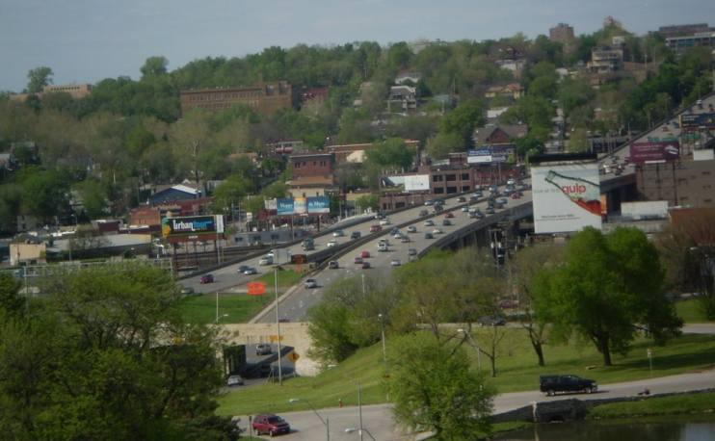
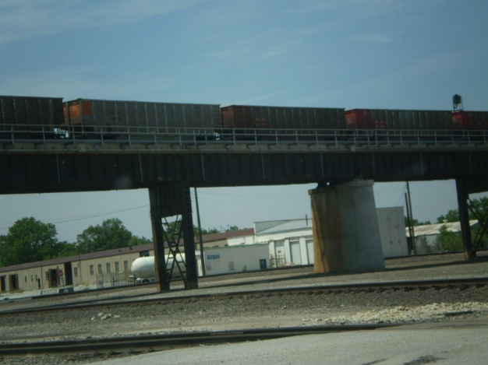
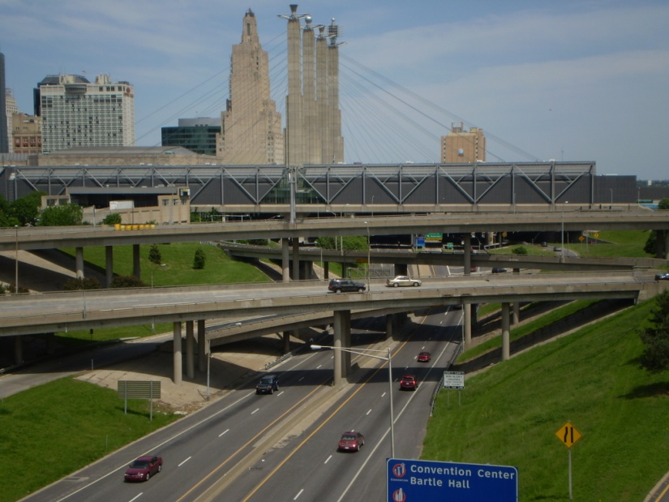
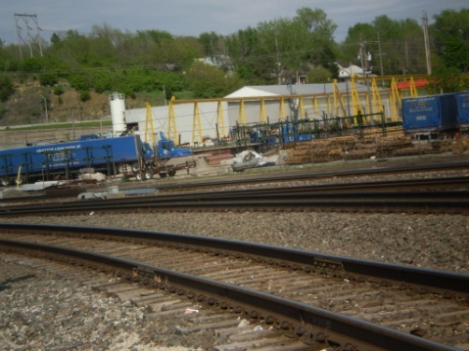
Essential Public Infrastructure
Transportation infrastructure:
Highways, Federal and State
Streets and Roads
Railroad tracks, rail yards
Bridges
Public transportation facilities

Slide 8
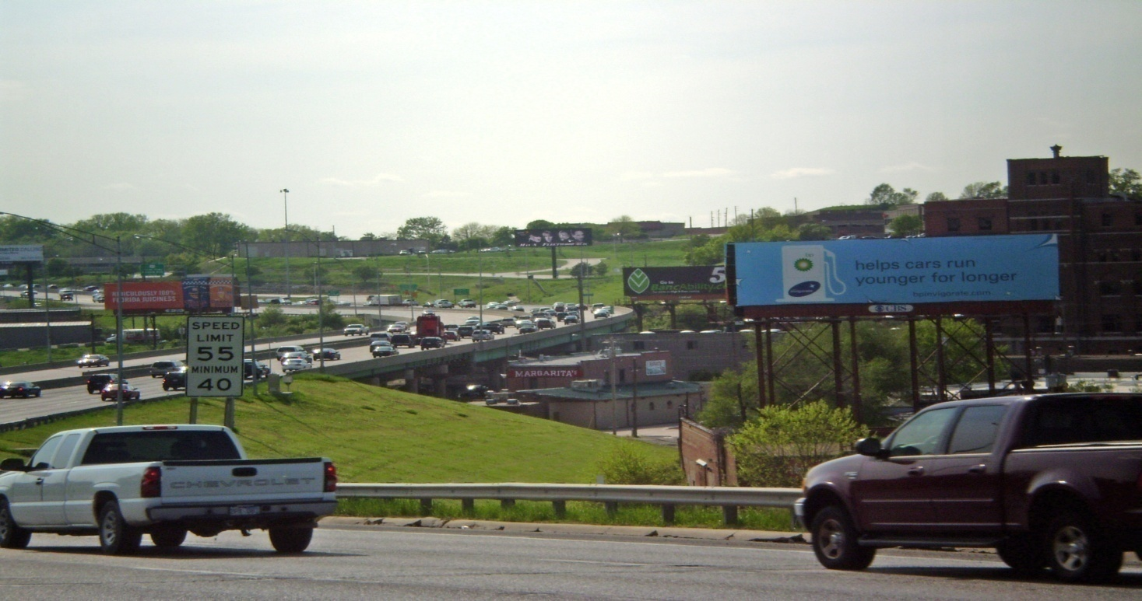
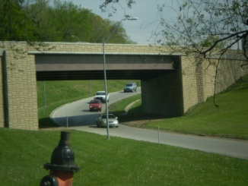
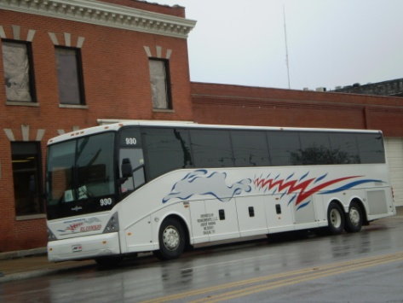
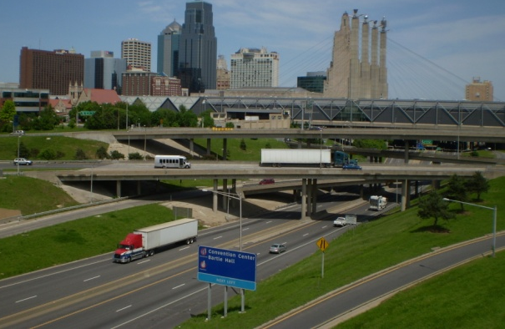
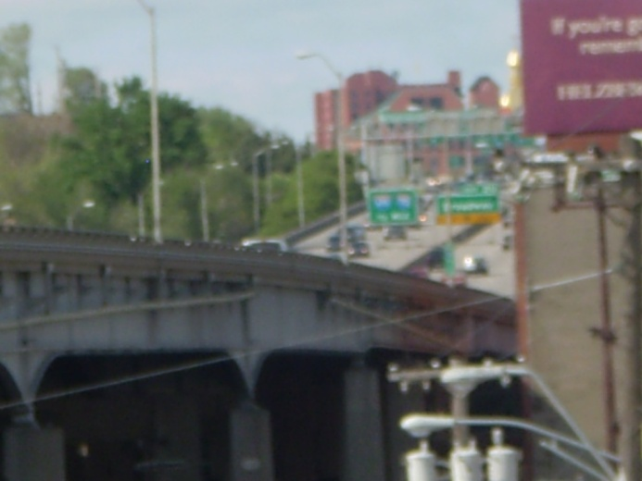
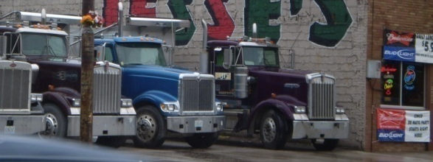
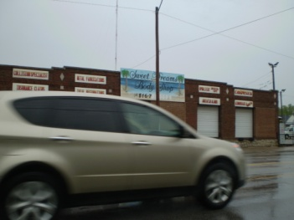
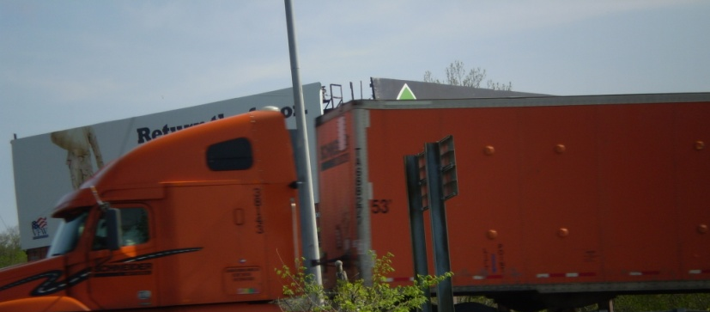
The Westside can experience 1,000,000 (one million+) vehicles per month
I-35
I-670
Broadway
State Line Road
Southwest Blvd.
Southwest Tfwy
Jarboe Street
Summit Street
31st Street

Slide 9

The Air That We Breath
Environmental Stressors of the Highway and Road Systems on the Westside-
Air pollution
(Those pollutants included: ozone, particulate matter, Elemental carbon sulfur dioxide, nitrogen dioxide, carbon monoxide, and lead.
Gasoline - Evaporation of gasoline from fuel systems while cars are running contributes to smog which can form ‘ozone’. Ground-level ozone is an air pollutant with harmful effects on the respiratory systems
Diesel [diesel exhaust particulate (DEP)]
Tire particles (particulate matter) Associations have been found between
day-to-day inhalable particulate air pollution and increased
risk of various adverse health outcomes, including cardiopulmonary
mortality and respiratory health problems from emissions

Slide 10
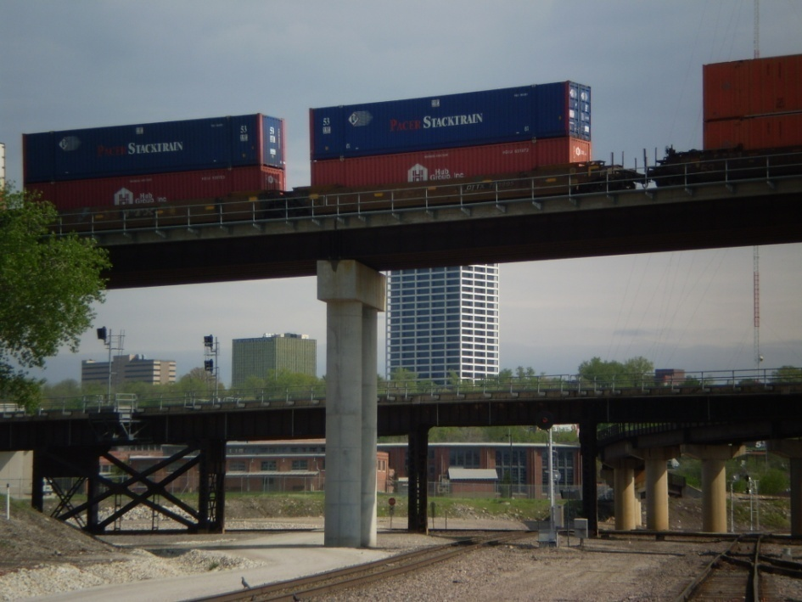
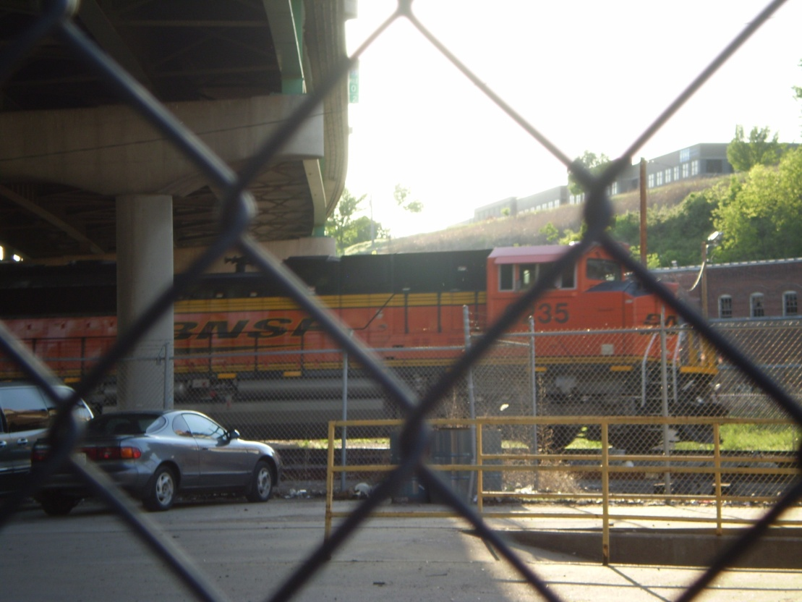
Railroads are environmental hazards and stressors
The Westside experiences thousands of train cars a month:
*diesel engine exhaust
*carrying coal to the electric power plants,
*carrying chemicals
*carrying hazardous waste
*carrying combustible organics (wheat, corn etc.)
Trains contribute to air pollution
Noise pollution
Pollute the ground through leakage of chemical cargos and the petro chemicals needed for the mechanics of the cars
The railroads use pesticides along the tracks and the right of way

Slide 11
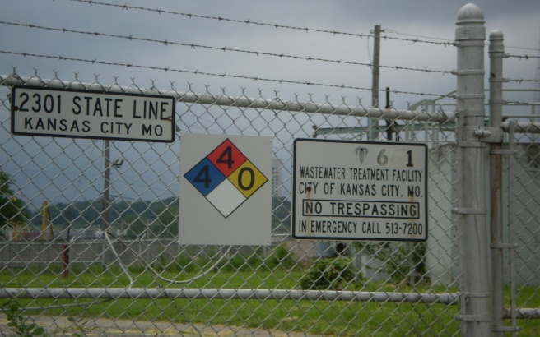
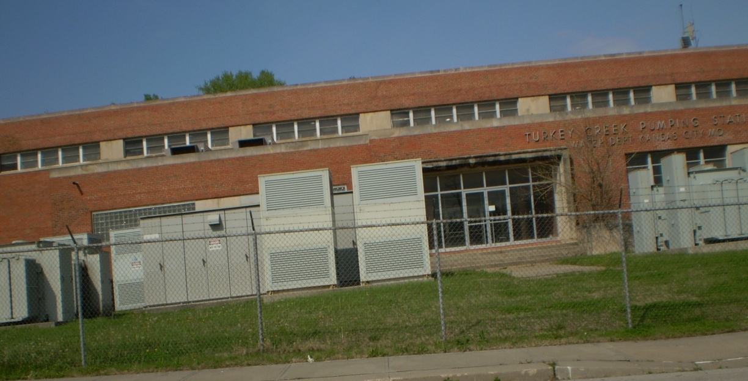
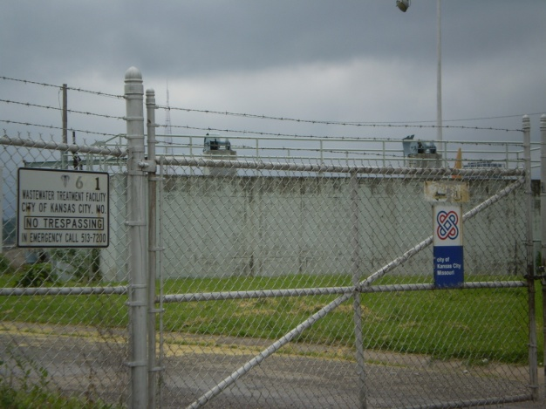
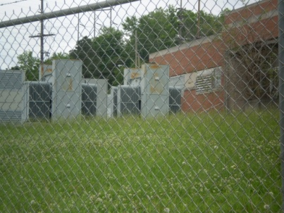
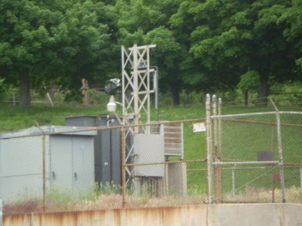
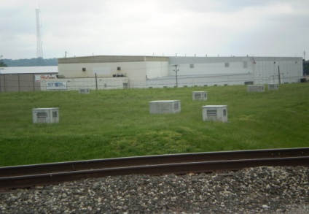
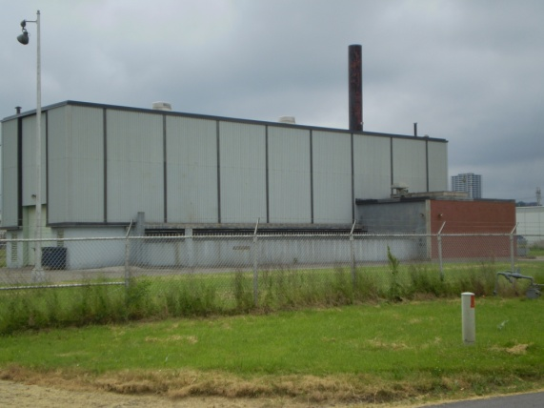
Essential Public Infrastructure
.
KCMO Water Dept
Turkey Creek Pumping Station – Allen Street
Water treatment & pumping stations
Waste water pumping stations
Sewers

Slide 12
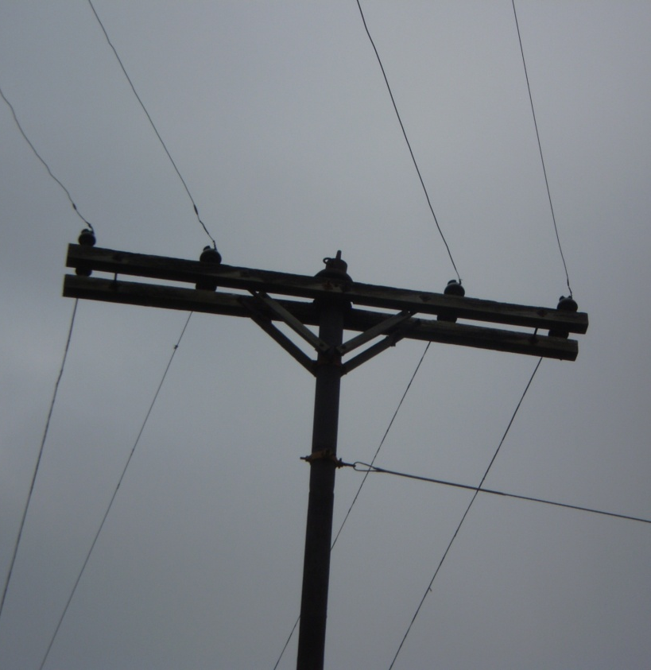
Essential Public Infrastructure
Electrical Substations
Chemicals which can be found in substations include dielectric fluid, transformer oil, Edisol XT, sulfuric acid and sulfur hexa-fluoride. Which serve to insulate and cool the electrical conductors.
Transmission lines scar the skies marring the landscape – visual blight
Transformers in substations have been constructed using highly toxic chemicals such as Polychlorinated Biphenyls, which can cause cancer.
Power plants & substations are not necessarily harmless, in 1999 KCP&L’s Hawthorn 5 Power Plant exploded just 9 miles east of downtown.

Slide 13
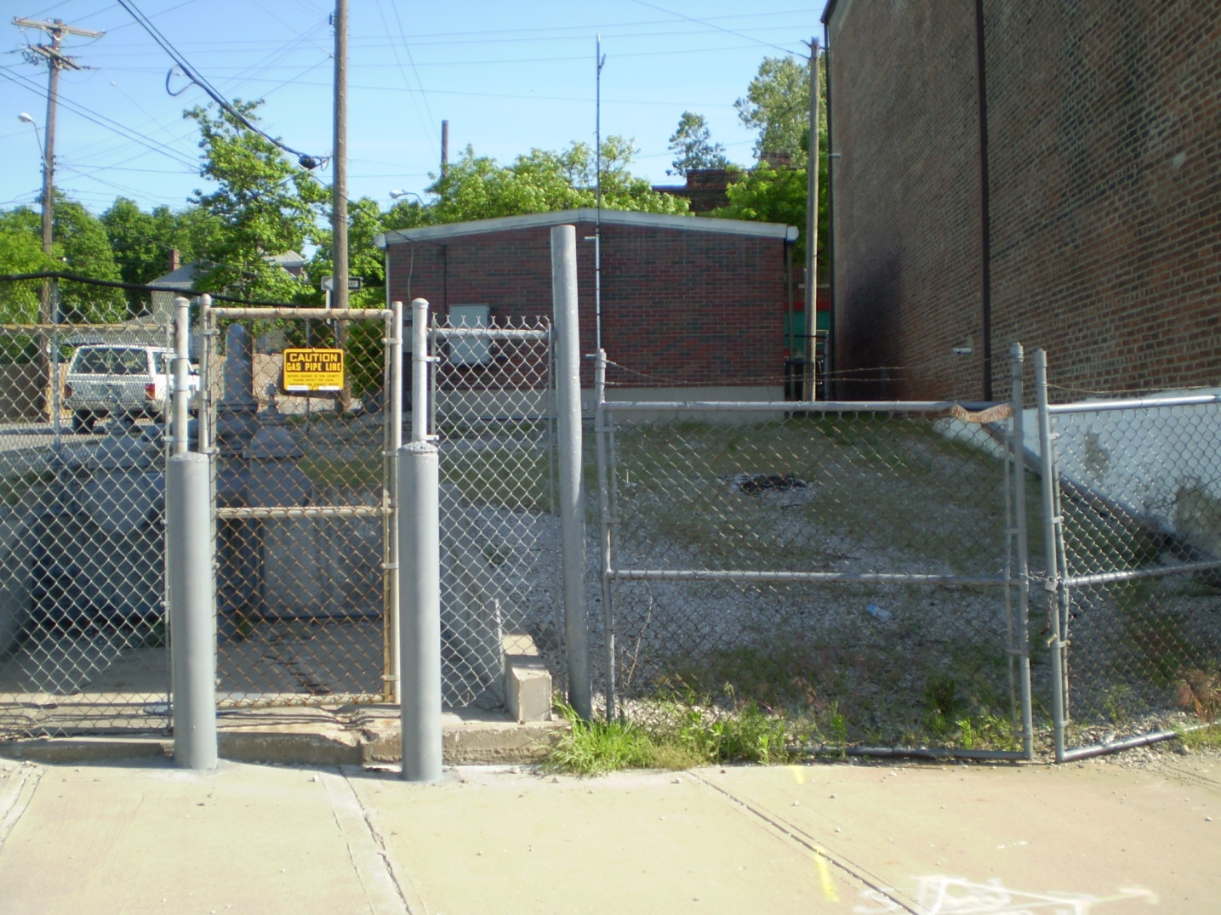
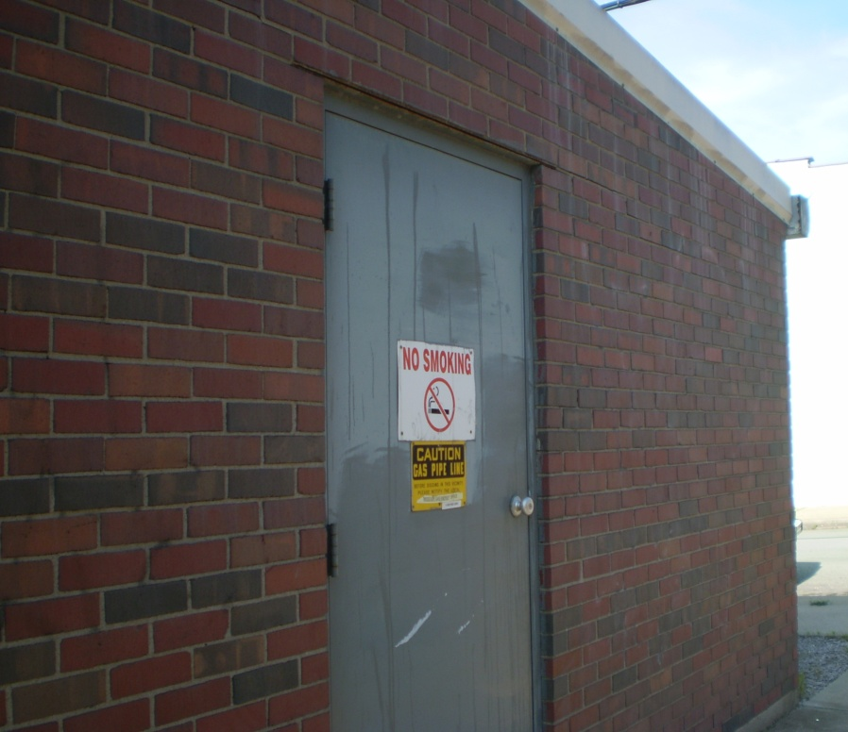
Essential Public Infrastructure
Missouri Gas Energy Pumping Station
This structure emits an odor like rotten eggs every day.
It emits a hissing sound all the time.

Slide 14
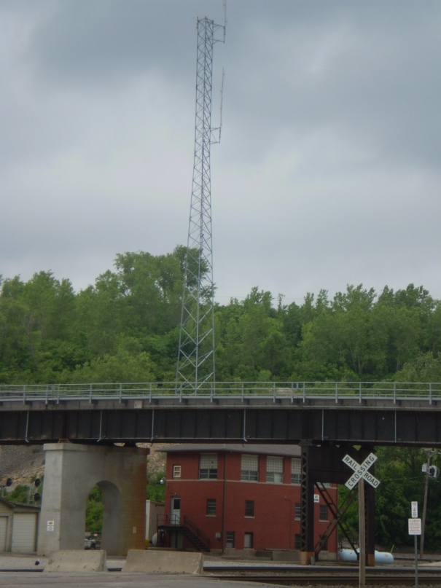
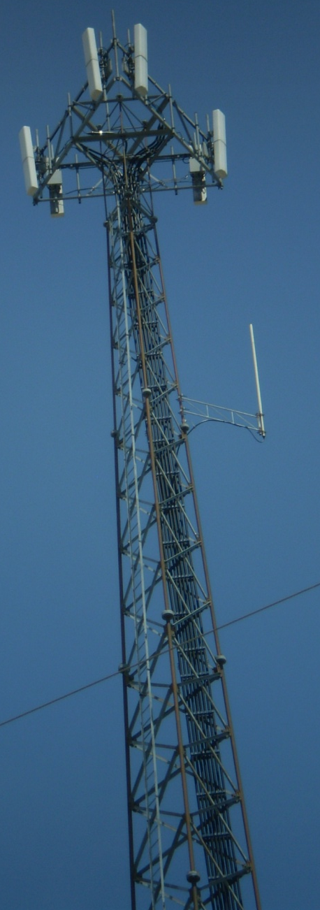
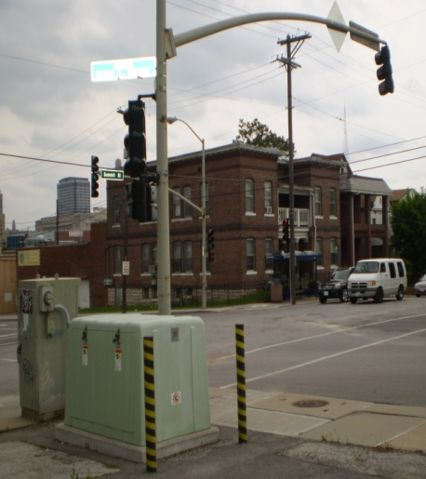
Essential Public Infrastructure
Boxes for phone companies
Communications infrastructure
Radio towers
Television towers
Satellite dishes, microwaves
Fiber optic cable (generally buried but you can see the manholes in the sidewalks)
Communications structures
The railroads have their own radio/electronic communications systems

Slide 15
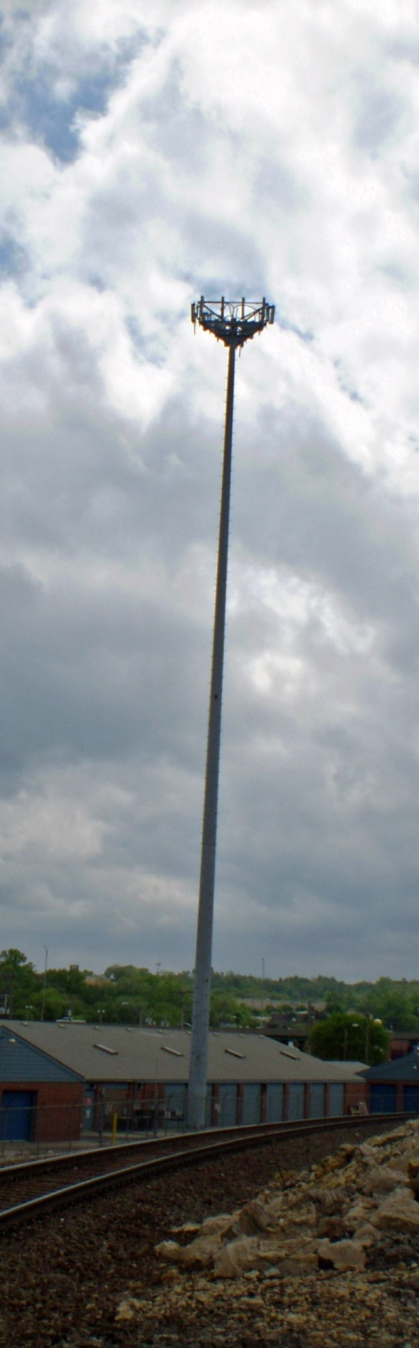
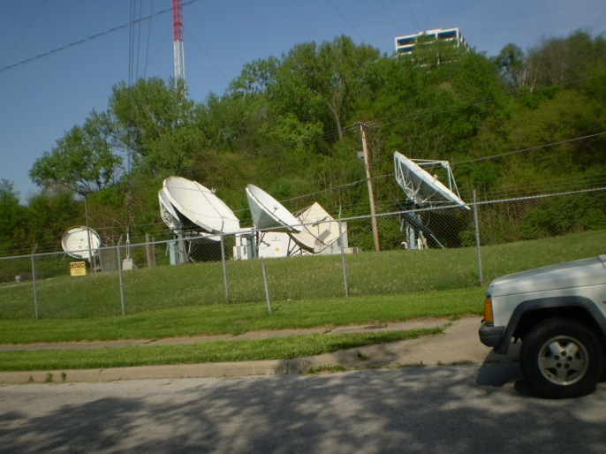
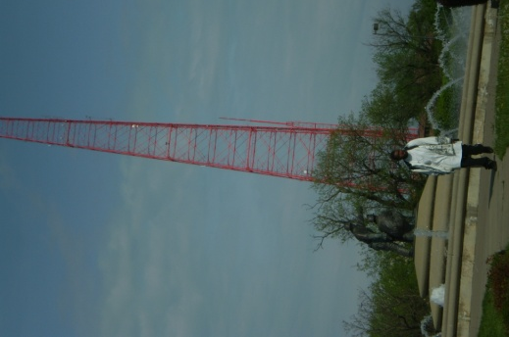

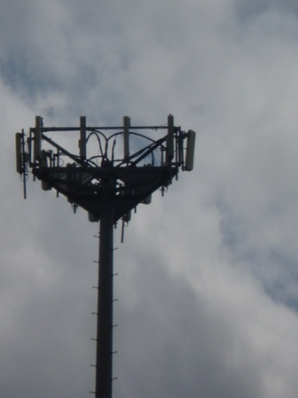


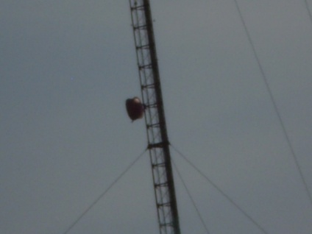
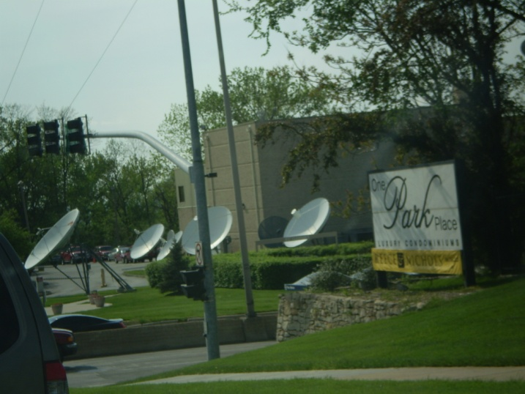
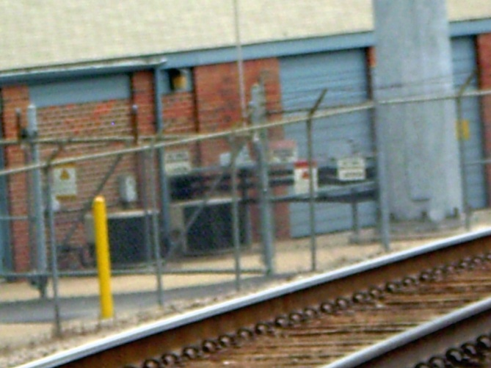
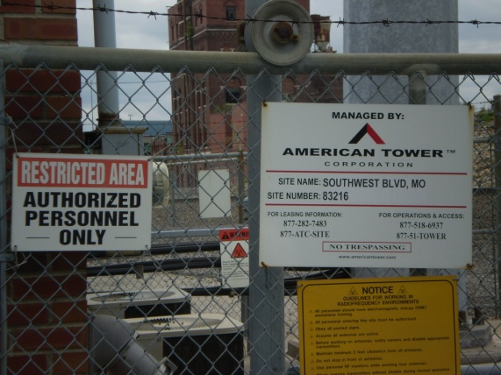
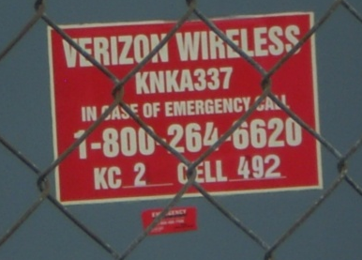

Radio Waves, Microwaves are all environmental risk factors and stressors ; they contribute to visual blight
The Westside is home to
4 cell towers
20+ satellites at WDAF
1 tv/radio transmission tower
Railroad radio communications

Slide 16

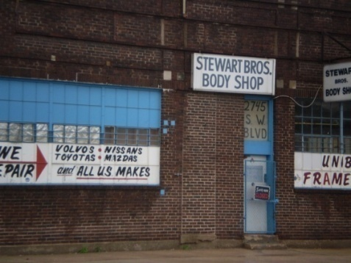
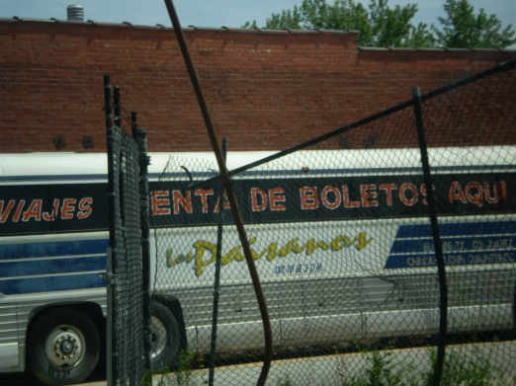

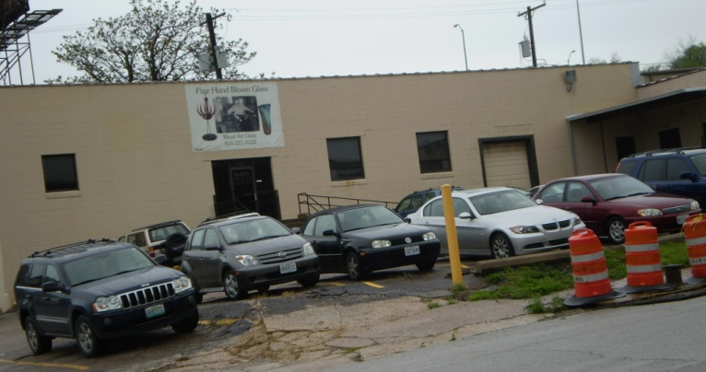
Fleet Management
Fleet the management is how we choose to operate our vehicles and amount of toxins they put in the air. Examples:
El Conejo or Los Paisanos leave their buses running for 30 minutes to heat or cool the buses
Scott Heller Trucking – the truck drivers warm up or leave their trucks running
Automotive repair companies that keep cars running while trying to repair
The taxi cab company drivers keep their cabs running while they check
Petrochemicals leak into the soil, air is polluted by gases.

Slide 17
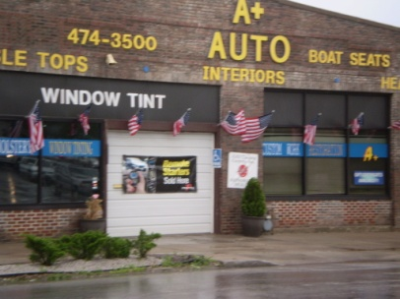
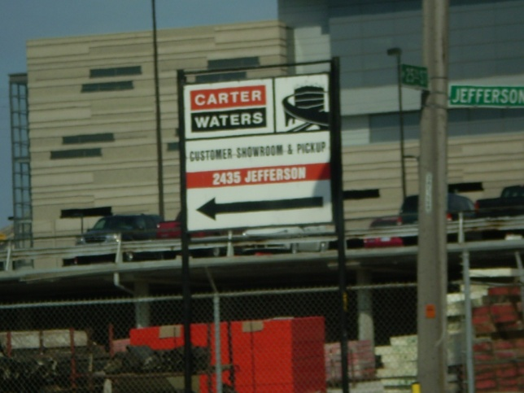
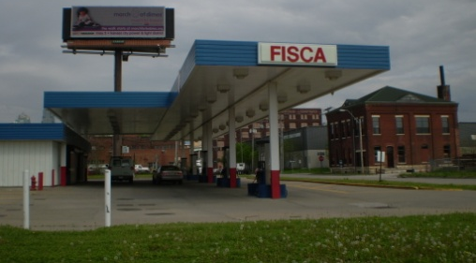
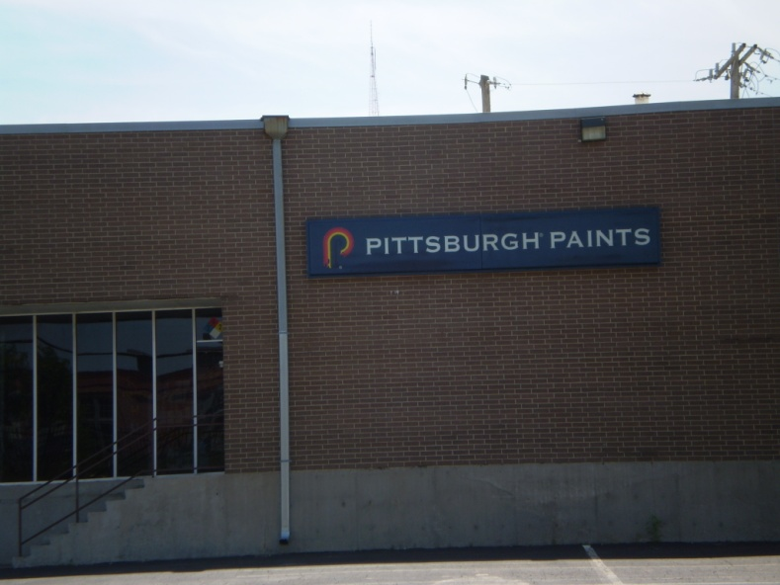
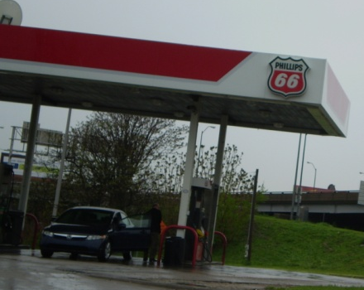
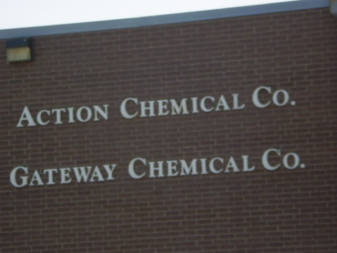
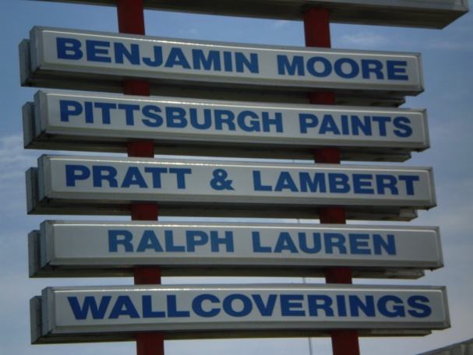
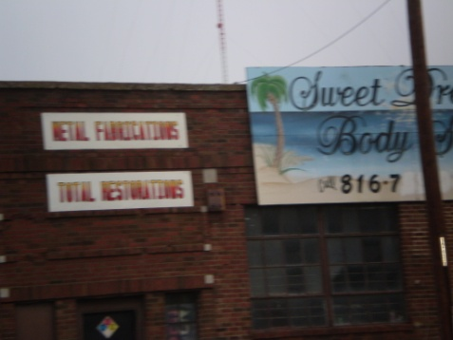
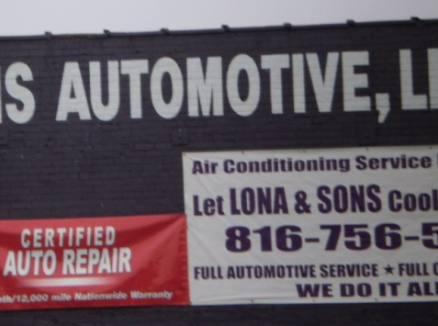
Toxins & Chemical Combustibles
Each time a company opens up a paint can or a bottle or can of solvent, toxic fumes are released
Every time you put gas in your car
Every time a gasoline distributor fills their tanks
These petro-chemical products are stored and are at risk for combusting into fire or exploding

Slide 18




Combustible Organics
The Roasterie
Boulevard Brewing Company
Perez Foods
Grain elevators
Parise Brothers Coffee
Schutte Lumber
Pacific Mutual Door Company
Combustible Organics are natural materials that have the capacity to ignite or start on fire under certain conditions.
Combustible organics are an environmental risk factor

Slide 19








Blight is an environmental stressor
Vacant and abandoned buildings
Ill-kept properties (need paint, weeds,)
Graffiti
Visual blight from signs and poles,
Trash and litter can be health hazards as well as visual blight
Abandoned, non-working vehicles
Billboards and signage
Light blight from lit signage, street lights, building lights
Noise blight (includes vibrations)– traffic, equipment, airplanes, trains

Slide 20






Environmental Stressors & hazards can include bars and nightclubs and liquor stores
Impaired drivers
(drugs/alcohol)
Drag racing
Gun shots
Fights & disorderly
conduct
Litter
Loud music
Public urination
Discarded used condoms
These stressors may also be public safety and public health hazards

Slide 21



KCP&L
Westside
2nd KCP&L
Substation

Slide 22



Environmental Justice
When governments or corporations continue to construct more and more environmental burdens or polluting industries in a single or specific residential neighborhood , this is “environmental injustice.”
Therefore, we are opposed to the
construction of the 2nd KCP&L substation as an environmental justice issue. We have more than our fair share of public burdens.
KCP&L substation at 18th & Cherry

Slide 23


Environmental Justice & Pollution
Environmental justice (EJ) refers to inequitable environmental burdens borne by groups such as racial minorities, women, residents of economically disadvantaged areas, or residents of developing nations. Environmental justice proponents generally view the environment as encompassing "where we live, work, and play" (sometimes "pray" and "learn" are also included) and seek to redress inequitable distributions of environmental burdens (pollution, industrial facilities, crime, etc.) and equitably distribute access to environmental goods such as nutritious food, clean air & water, parks, recreation, health care, education, transportation, safe jobs, etc. Self-determination and participation in decision-making are key components of environmental justice.
The term pollution usually refers to human activities that harmfully affect the world around us. More often than not, it comes attached to other general terms related to the ecosystem, such as air pollution or ocean pollution, or to a human sense, such as noise pollution or light pollution.

Slide 24

Westside Air Quality – it’s not just the highways and streets
Primitivo Garcia School ranked in the 15th percentile of USA schools with toxic air quality.
USA Today in a special feature entitled “The Smokestack Effect, Toxic Air and America’s Schools” reported that the four schools in our neighborhood (Primitivo Garcia School, Alta Vista, Our Lady of Guadalupe and Douglass School) rank in the 14th & 15th percentile for exposure to cancer causing toxins in the air and air patterns we catch toxic air emissions from Armourdale, Rosedale, Fairfax and North Kansas City.
http://content.usatoday.com/news/nation/environment/smokestack/interactive/7

Slide 25
Primitivo Garcia School ranked in the 15th percentile of USA schools with toxic air quality
Chemicals most responsible for the toxicity outside this school
Formaldehyde 32% of overall toxicity
Manganese and manganese compounds 21% of overall toxicity
Trimethylbenzene, 1,2,4- 11% of overall toxicity
Sulfuric acid 7% of overall toxicity
Ammonia 6% of overall toxicity
Polluters most responsible for toxics outside this school
Owens Corning Kansas City, Kansas
CertainTeed Corp Kansas City, Kansas
Griffin Wheel Co Kansas City Plant Kansas City, Kansas
Gm Midsize & Luxury Car Group (Mlcg) Fairfax Assem Kansas City, Kansas
Nearman Creek Power Station Kansas City, Kansas
Sources: U.S. Environmental Protection Agency, University of
Massachusetts at Amherst Political Economy Research Institute
* Chemicals most responsible for the toxicity outside this school may
not add up to 100% because only the top chemicals are listed.

Slide 26


History of the DST Site
In 1999-2000 over $2.3 million dollars of tax payer money was used to remove 60,000 cubic yards of contaminated soil and cinders in order to create the Westside Business Park . Over 50,000 tons of arsenic-impacted soil and approximately 3,000 tons of petroleum-impacted soil were removed from the property
Now DST is allowing another environmental risk and blighting element on this site.
This project was partially funded with a $7.1 million HUD Community Development Block Grant and a $7.1 million HUD Section 108 Loan. The project also received $100,000 from the State Department of Economic Development to be used for environmental due diligence.
These are your tax dollars.
The Westside Business Park, a participant in the Missouri Department of Natural Resources' Brownfields/Voluntary Cleanup Program, received the U.S. Environmental Protection Agency's (EPA) 2003 Phoenix Award for excellence in brownfield redevelopment. The award recognizes the site, located on Southwest Boulevard in Kansas City, as one of the nation's premier brownfield redevelopment projects.

Slide 27
Is it responsible for DST to ‘rent’ space forever to an environmental burden and eyesore?
The Westside should not have to bear the burden of one more environmental burden of one more piece of essential infrastructure.
Kansas City consists of 330 square miles and 300 neighborhoods, surely not everything has to built in the Westside.
“Cheap and Easy.” says KCP&L. It’s not cheap and easy for us. It’s not cheap to pay medical bills due to environmental pollutants, it’s not easy to breath from pollution induced asthma, lung and heart disease.
Cheap and easy for whom?
It is morally wrong for KCP&L to construct another polluting burden in our neighborhood.
We understand the need for electricity. That’s not the point. The point is – the substation needs to be built elsewhere in the City of Kansas City, MO where it will be less of a burden.

Slide 28


Imagine This
← This is a concept of a KCMO downtown street.
Can you envision?
Can you imagine?
This could be Southwest Boulevard as you look west from Boulevard Brewery?
Conceptual application of Transit-Oriented Development
picture from the Greater Downtown Area Plan, Land Use Section 2009 http://plandowntownkc.com/
Or will KCP&L’s substation dissuade potential great –commercial and residential development from the Westside because of this?→

Slide 29



Who To Contact -Tell Them “NO”
Mr. Michael Chesser
Chairman and Chief Executive Officer
Great Pains Energy & KCP&L
P.O. Box 418679
Kansas City, MO 64141-9679
DST Systems, Inc.
Mr. Vince Dasta
President
DST Realty
333 W. 11th Street
Kansas City, MO 64106
Thomas A. McDonnell
Chief Executive Officer, President and Director
DST Systems
333 W. 11th Street
Kansas City, MO 64106
Mr. Michael Merriman
Chairman & President
Financial Holding Company
300 W 11th St
Kansas City, MO 64105-1618
KCMO – Plans & Zoning Committee
Councilman Terry Riley - Chairperson -(816) 513-1629
schylon_clayton@kcmo.org
Councilwoman Cindy - Co-Chairperson - 816) 513-1633
gina_boucher@kcmo.org
Councilwoman Beth Gottstein - j816) 513-1616 jim_giles@kcmo.org
Councilman Ed Ford - 816.513.1601
lisa_minardi@kcmo.org
Councilman John Sharp - (816) 513-1615
araceli_gallegos@kcmo.org

